Slide 1
Being agile with modern Java

Slide 2
Being agile?

Slide 3
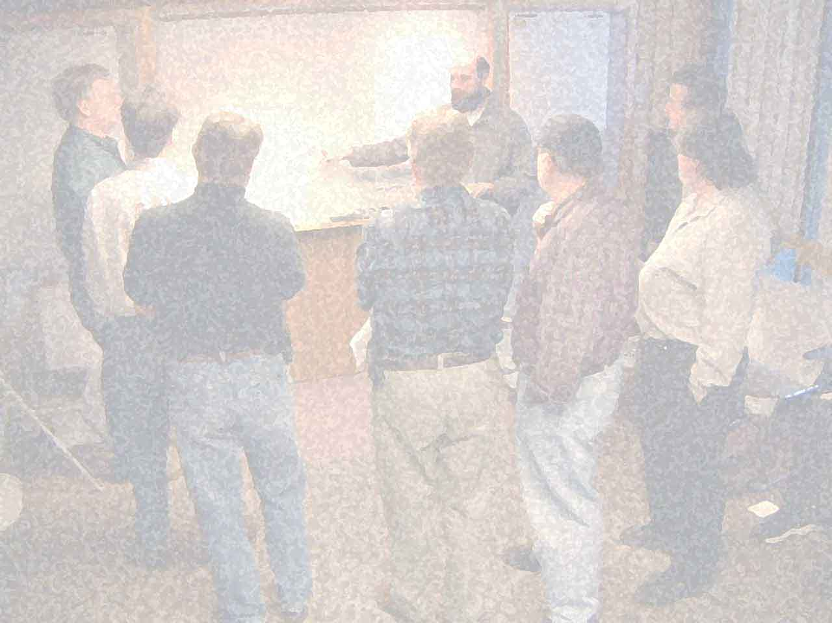

Slide 4
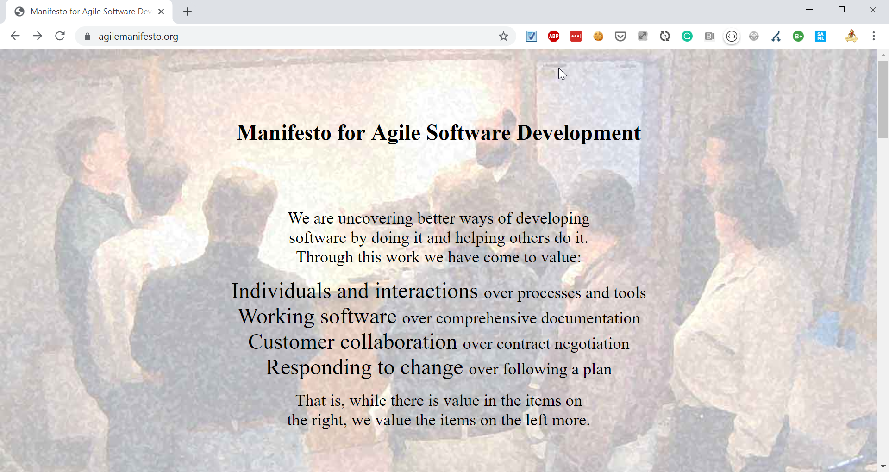
Notes:
JOKE: Old school HTML

Slide 5






(… at that time)
PROBLEMS

Slide 6
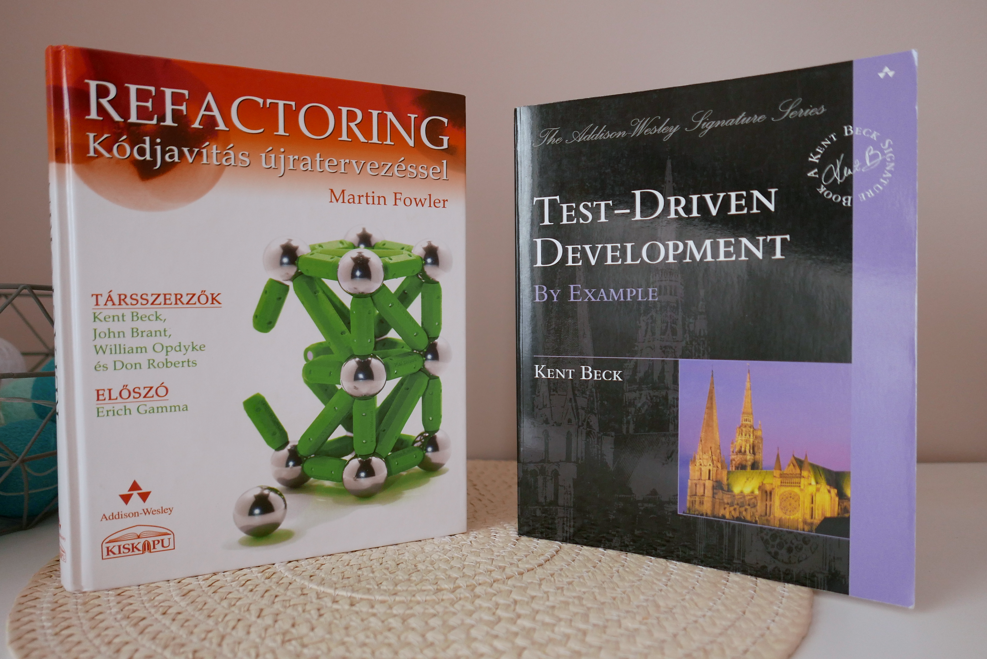

Slide 7
Being agile?

Slide 8
Thinking agile?

Slide 9
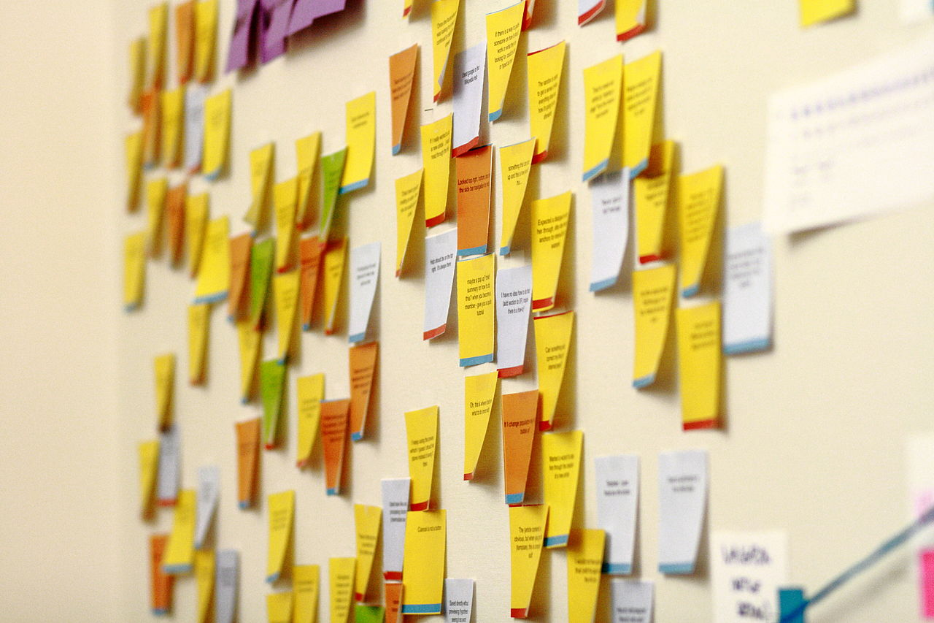

Slide 10
continuous optimization
simplification
small iterations
small experiments
AGILE
baby steps
stabilization
Notes:
EXAMPLE: Refactoring & TDD are using these approaches

Slide 11
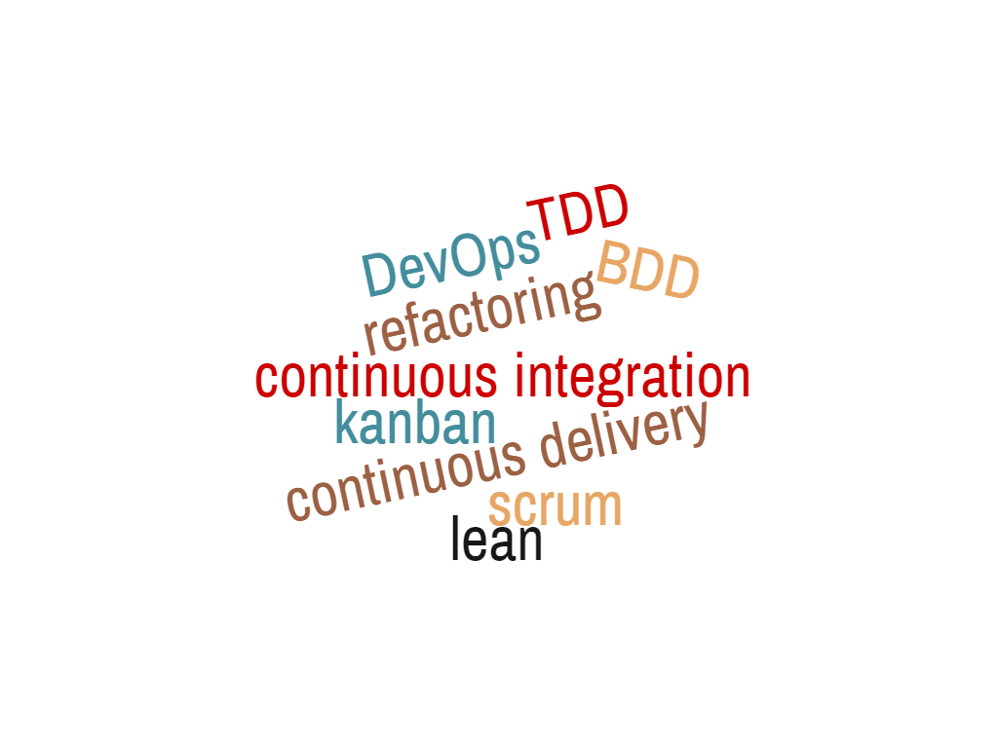
SAME APPROACH
Notes:
Example – how you can improve slow deployments
Word Cloud:
1 continuous~integration
1 continuous~delivery
1 refactoring
1 kanban
1 DevOps
1 scrum
1 lean
1 TDD
1 BDD

Slide 12
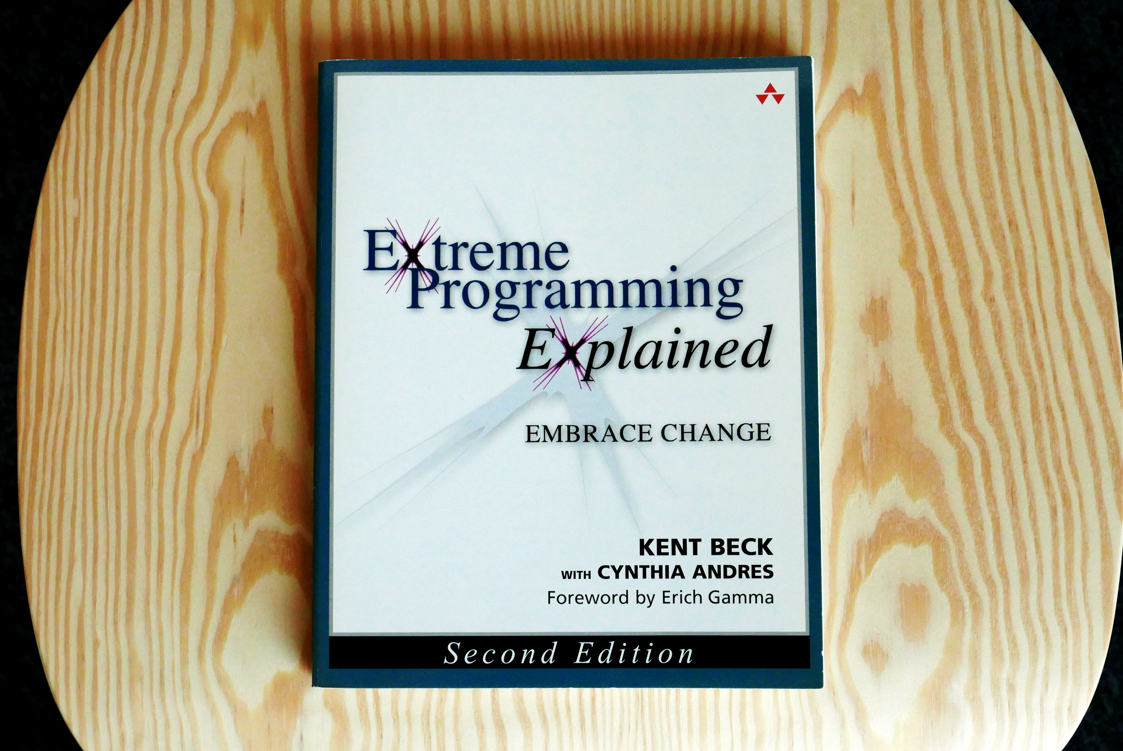

Slide 13
CI

Slide 14
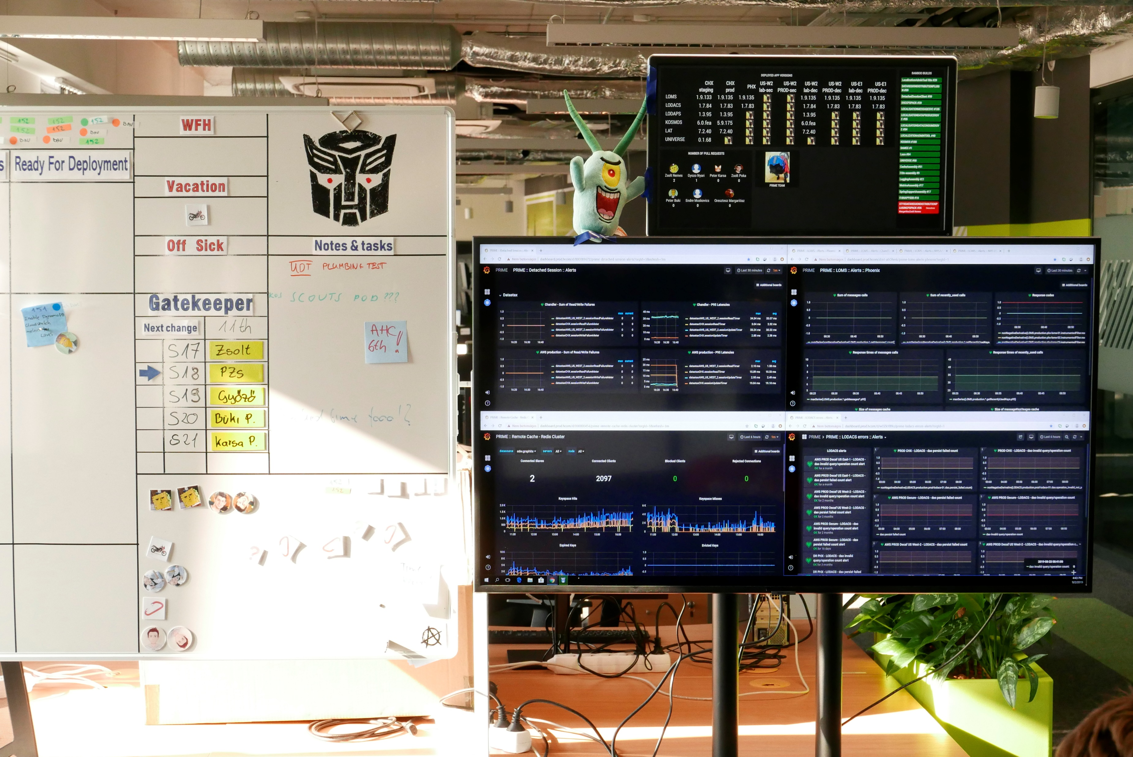
CI

Slide 15
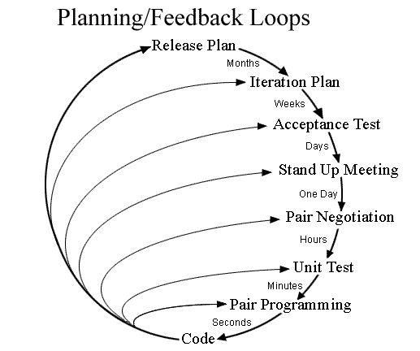
Notes:
Switch to faster feedback, when doubts: pairing

Slide 16
pipeline as code
living documentation
continuous testing
generators
containers
hotswap
code

Slide 17
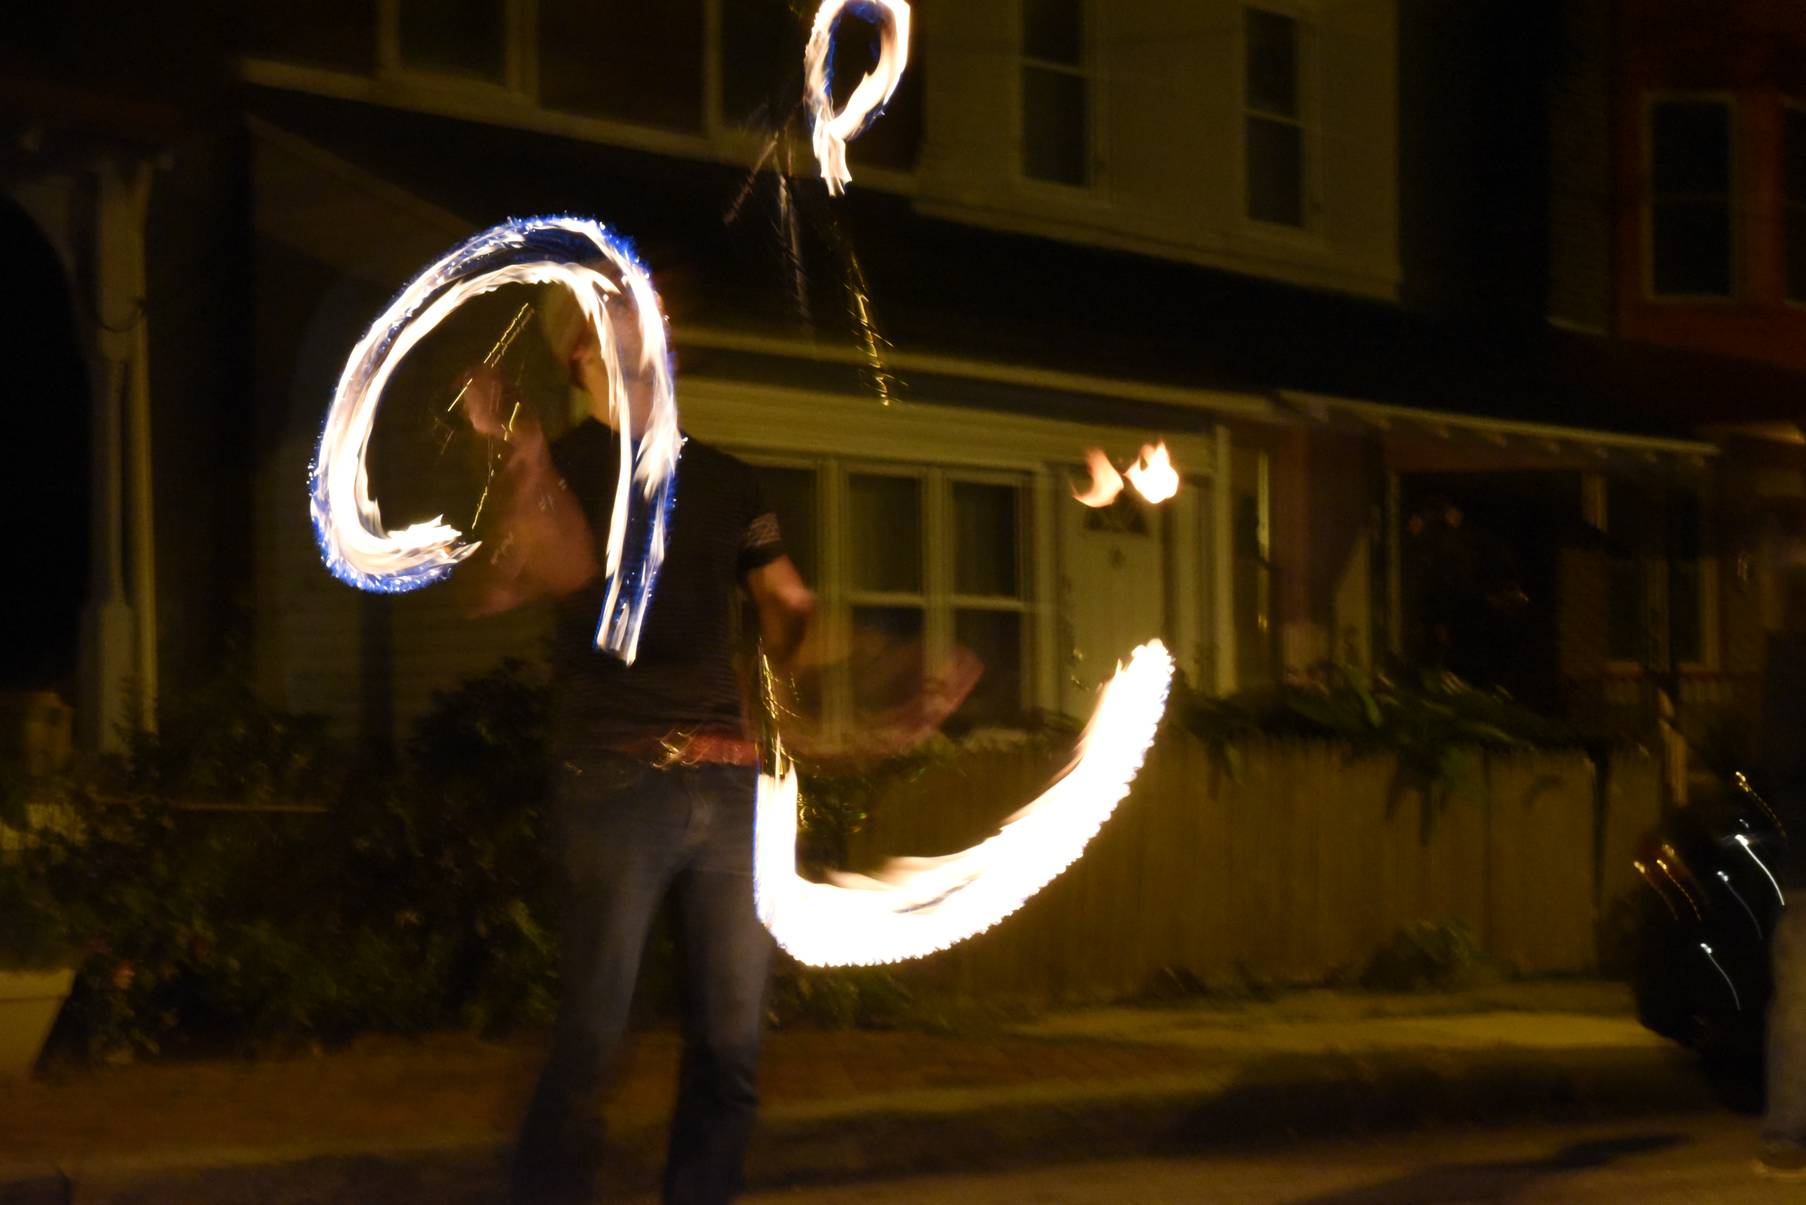
HOTSWAP

Slide 18
Ctrl+F9
Notes:
Works with Node.JS, Angular, Spring Boot, Play FW, Jhipster

Slide 19

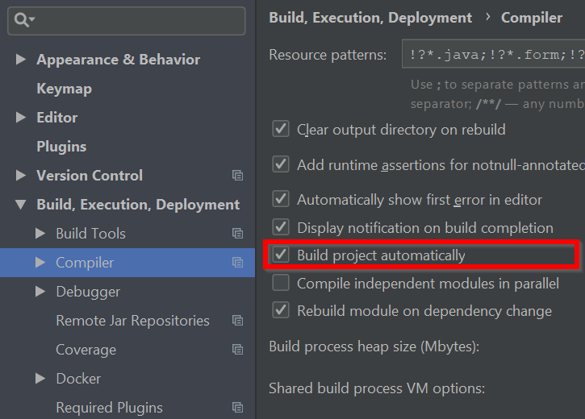

Slide 20
0 cost
1st thing to do
don’t block hotswap
hotswap the whole day
Notes:
Agile: simplification, small experiments, continuous optimization, baby steps
Metrics: fast feedback, usability, simplicity

Slide 21

CONTAINERS

Slide 22


Slide 23








SAML 2.0
S3

Slide 24


VS
Notes:
3 seconds and 30 seconds make a difference

Slide 25
apiVersion: apps/v1
kind: Deployment
…
spec:
…
template:
spec:
containers:
- name: …
…
---
apiVersion: v1
kind: Service
metadata:
name: mysql
…
version: '3'
services:
toxiproxy:
image: "shopify/toxiproxy"
redis-master:
image: "redis:alpine"
redis-slave:
image: "redis:alpine"
mysql:
image: mysql:5.6
…

Slide 26



Slide 27

plugins { id 'com.google.cloud.tools.jib' version '1.4.0’ }
./gradlew jibDockerBuild \
--image=agile-springboot:latest

Slide 28
apiVersion: skaffold/v1beta13 kind: Config build: artifacts: - image: agile-springboot deploy: kubectl: manifests: - src\main\kubernetes\agile-springboot.yml - src\main\kubernetes\mysql.yml
eval $(minikube env)
skaffold init
skaffold dev

Slide 29
fastest orchestrator locally
use embedded dependencies if needed
don’t depend on your orchestrator
dependencies living documentation
don’t block hotswappin’
Notes:
Agile: simplification, small iterations, small experiments, stabilization
Metrics: no snowflakes, no S.P.O.F, usability, fast feedback, simplicity

Slide 30
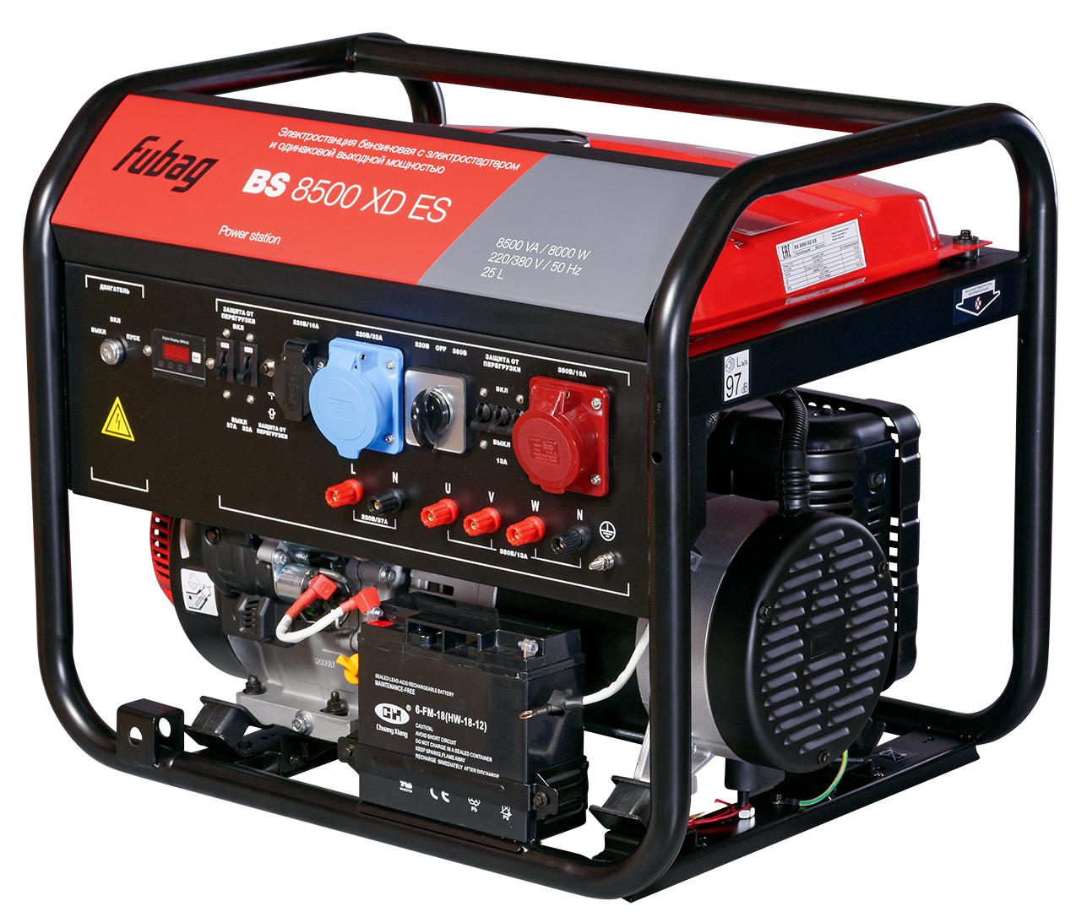
GENERATORS

Slide 31

CODE READING

Slide 32
CODE
=
DOMAIN

Slide 33



lombok

Slide 34
@Data @Entity public class Person { @Id private Integer id; private String firstName; private String lastName; }
@NoArgsConstructor public class LegacyPersonDTO { @Getter @Setter private String fullName; }

Slide 35
@Mapper public interface PersonToPersonDTOMapper { @Mapping(target = "fullName", expression =
"java(person.getFirstName()+\" \"+person.getLastName())") LegacyPersonDTO personToLegacyPersonDTO(Person person);
}

Slide 36
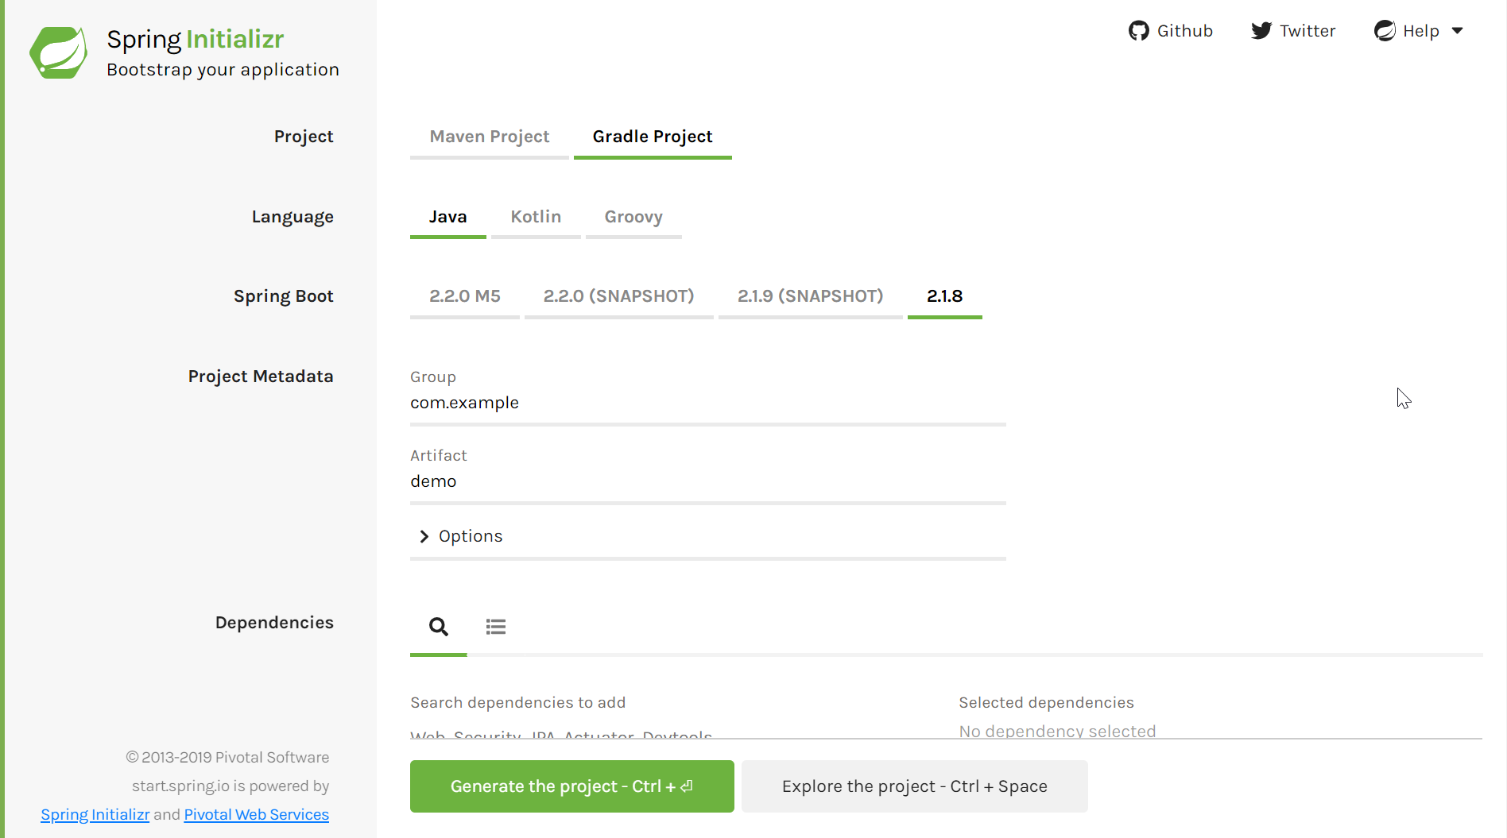

Slide 37
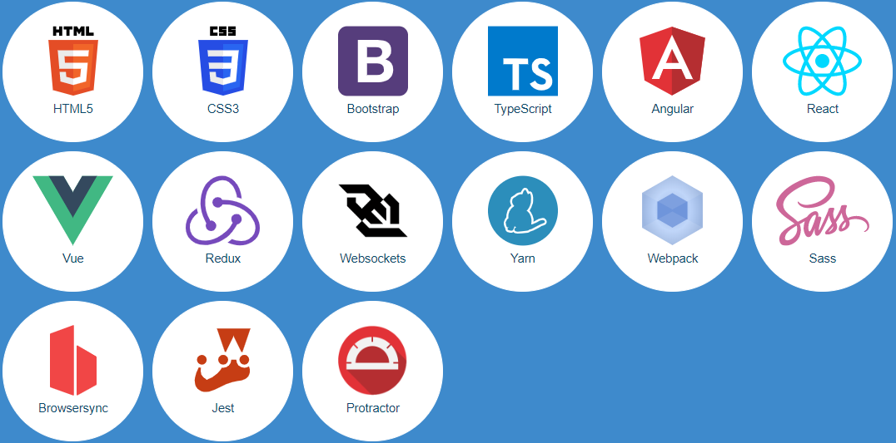
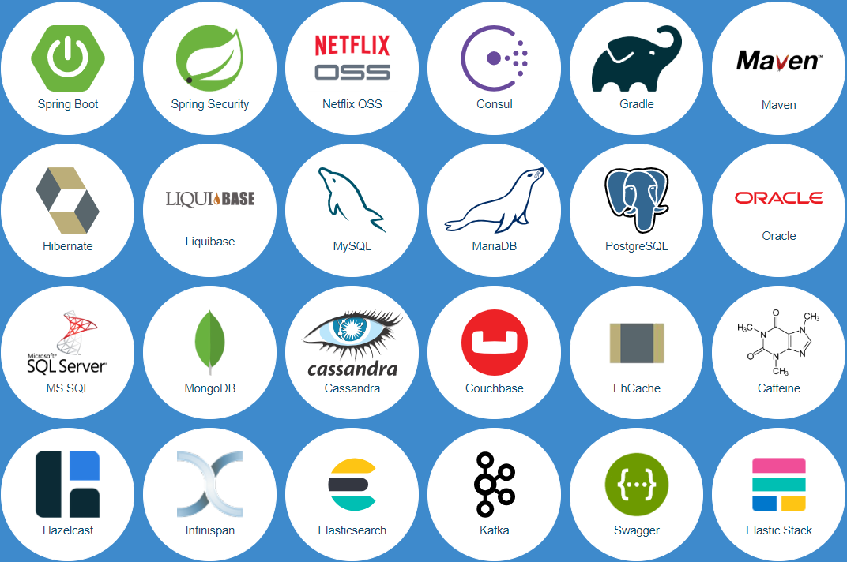

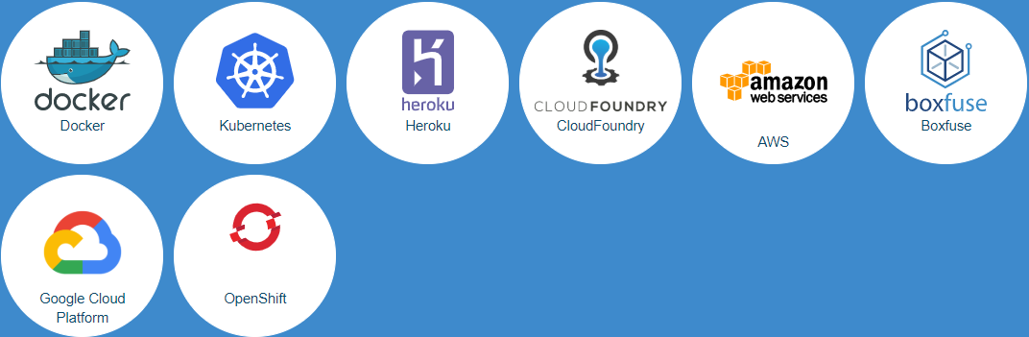
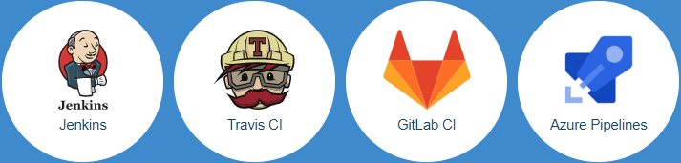

Slide 38
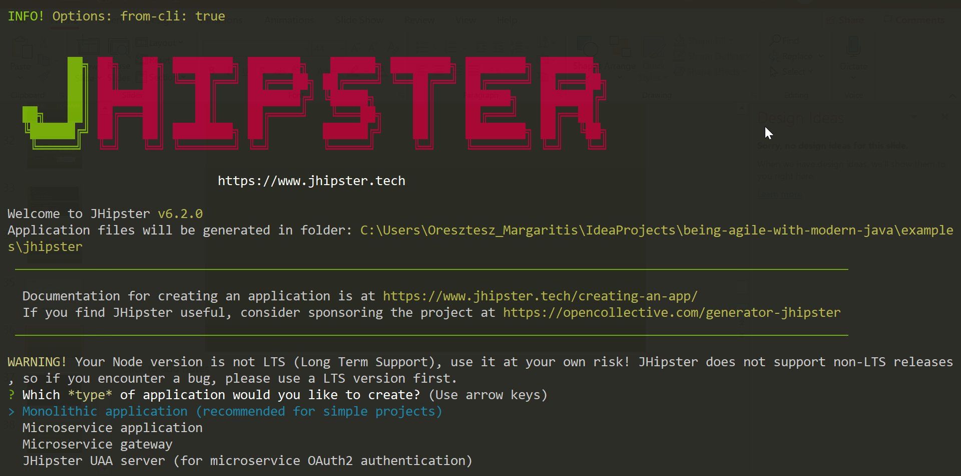

Slide 39
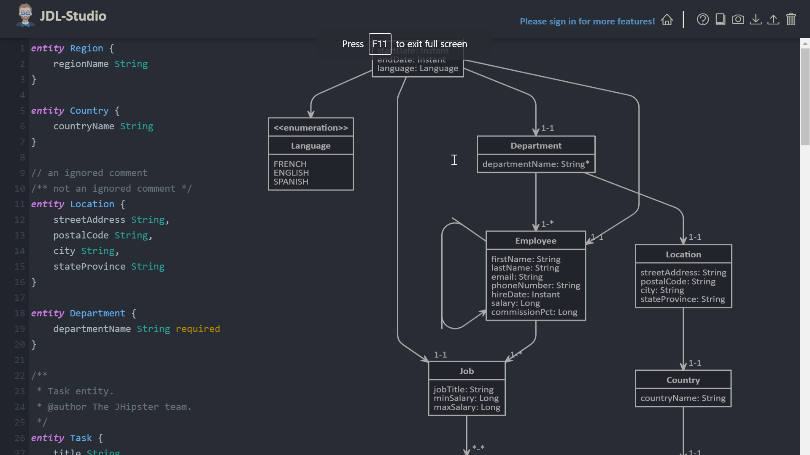

Slide 40
read less, write more
application runs from day 1
avoid stuck in re-generating everything
Notes:
Agile: simplification, small experiments, small iterations, baby steps
Metrics: simplicity, feature richness, usability

Slide 41

CONTINUOUS TESTING

Slide 42
MANUAL
END-TO-END
INTEGRATION
UNIT

Slide 43


MANUAL
INTEGRATION
UNIT
END-TO-END
DEV
QA

Slide 44


Mocha
Grinder
Selenium
JUnit
PyTest
Gatling
JMeter

Slide 45
@Test public void testGetPerson() throws IOException, InterruptedException { var getPersonRequest = HttpRequest.newBuilder() .uri(URI.create("http://localhost:8080/person/1")) .timeout(Duration.ofSeconds(10)) .header("Content-Type", "application/json") .build(); var getPersonResponse = HTTP_CLIENT.send(getPersonRequest, AS_STRING); Assert.assertEquals(200, getPersonResponse.statusCode()); Assert.assertTrue(getPersonResponse.body().contains("firstName")); Assert.assertTrue(getPersonResponse.body().contains("lastName")); }

Slide 46
--- execution: - executor: junit concurrency: 20 hold-for: 2m scenario: script: src/test/java reporting: - module: final-stats - module: console - module: passfail criteria: - avg-rt of testGetPerson>50ms for 10s, stop as failed - p99 of testGetPerson>120ms for 5s, stop as failed - fail of testGetLegacyPerson>50% for 10s, stop as failed modules: junit: compile-target-java: 11

Slide 47
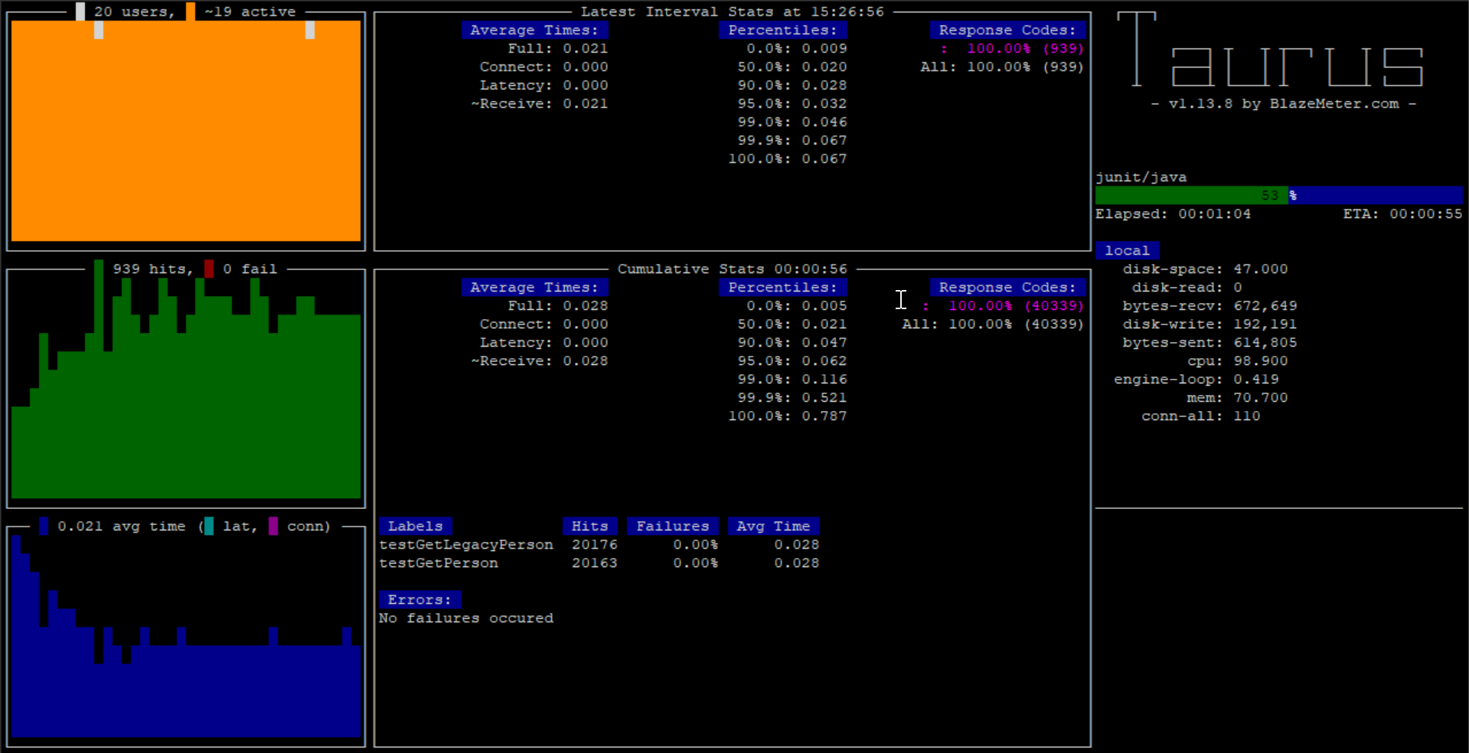

Slide 48
same review for all tests
use common language
re-use test cases
cheap high-level tests
Notes:
Agile: simplification, stabilization, continuous optimization, small iterations, small experiments
Metrics: simplicity, fast feedback, usability, feature richness, no snowflakes

Slide 49

LIVING DOCUMENTATION

Slide 50
/** * Feature that determines whether generator will automatically * close underlying output target that is NOT owned by the * generator. * If disabled, calling application has to separately * close the underlying {@link OutputStream} and {@link Writer} * instances used to create the generator. If enabled, generator * will handle closing, as long as generator itself gets closed: * this happens when end-of-input is encountered, or generator * is closed by a call to {@link JsonGenerator#close}. *<p> * Feature is enabled by default. */ AUTO_CLOSE_TARGET(true),

Slide 51
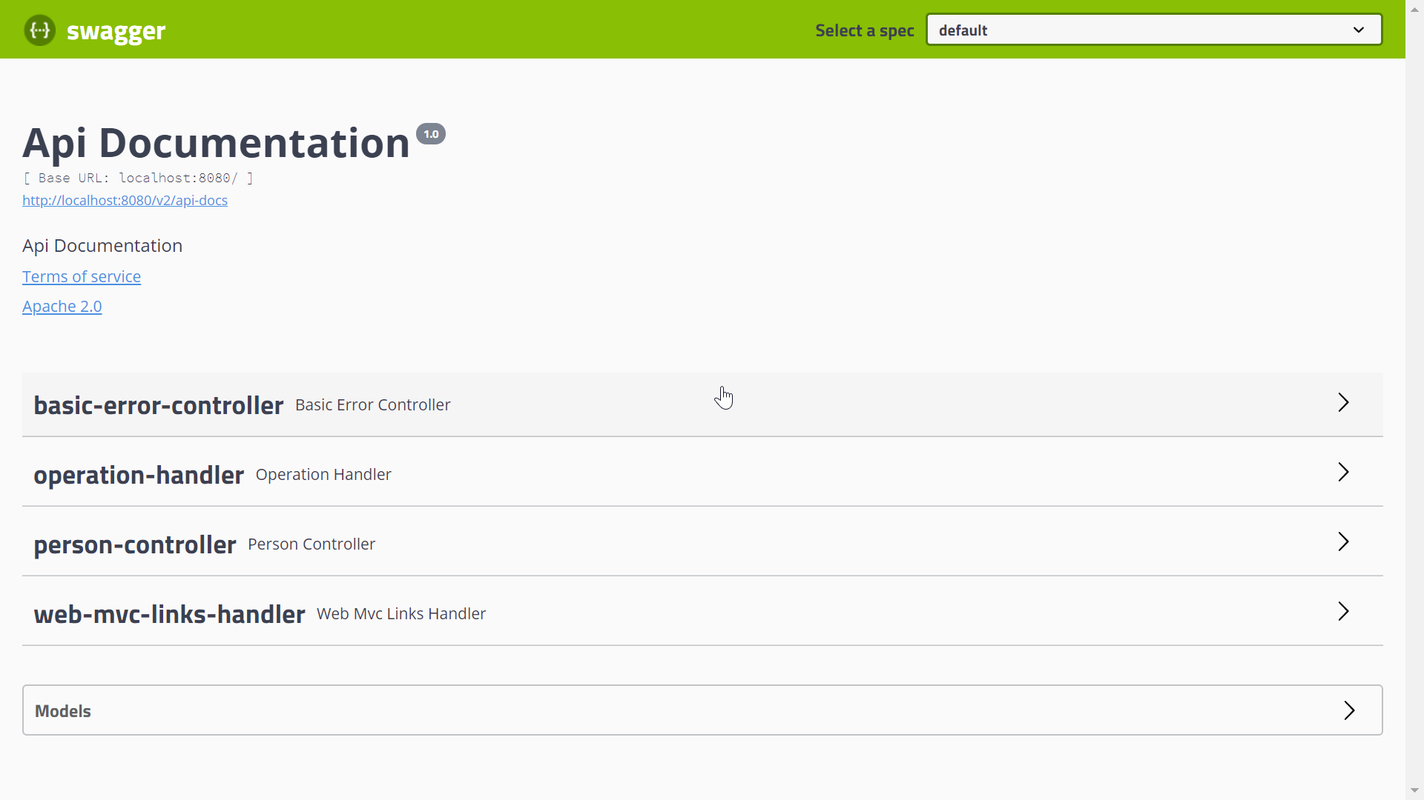

Slide 52



REST
Cucumber
REST
Toxiproxy

Slide 53
Feature: Storage availability scenarios for user service … Background: … Scenario: Read-only mode without MySQL Given 'MySQL' is down When user 'u-12345abde234' is requested Then the user with id 'u-12345abde234' is returned from 'Redis'

Slide 54
minimize traditional documentation
BDD is not just for e2e tests
“better design” over any documentation
Notes:
Agile: simplification
Metrics: simplicity, fast feedback, usability, feature richness

Slide 55

AS CODE
PIPELINE

Slide 56
pipeline {
...
stages {
stage('checkout') {
steps {
sh 'git config --global http.sslVerify false'
git branch: env.BRANCH_NAME, url: ’...' }
}
stage('test') {
agent {
docker {
image 'openjdk:11-jdk-slim'
...
}
}
steps {
dir(BASEDIR) {
sh "./gradlew clean test"
}
}
}
...
stage('deploy to lab') {
failFast true
parallel {
...
}
}
...
}
}

Slide 57
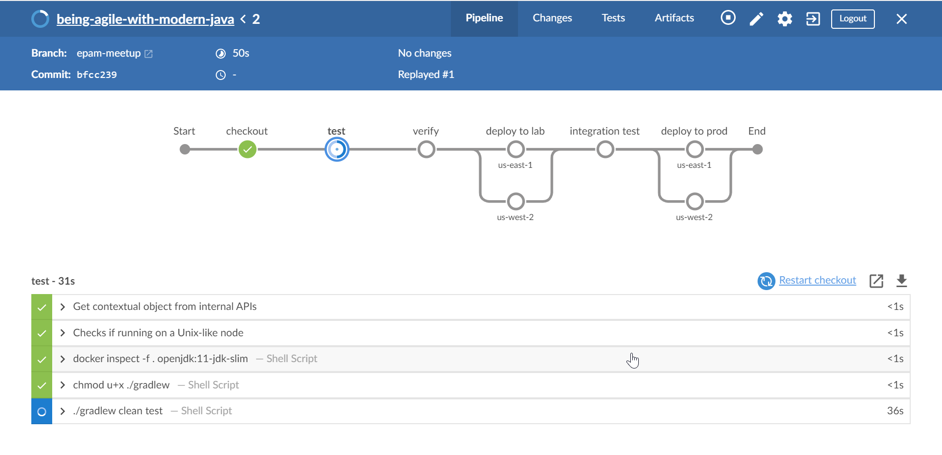

Slide 58
feature branches branch deploys
minimize CI/CD complexity !!!
keep pipelines version-controlled
Notes:
Agile: continuous optimization, simplification, small iterations, small experiments, stabilization, baby steps
Metrics: no snowflakes, no S.P.O.F, feature richness, usability, fast feedback, simplicity

Slide 59


continuous testing
pipeline as code
containers
living documentation
generators
hotswap

Slide 60
principles
practices
tools

Slide 61
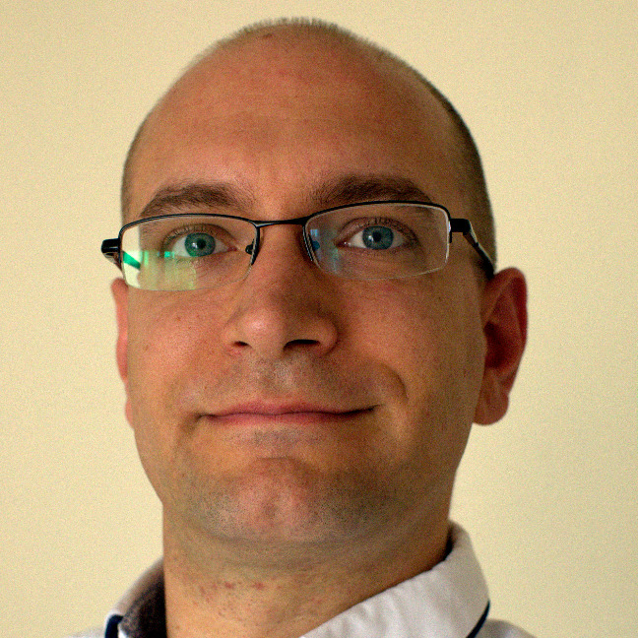




Thank you!
Oresztész Margaritisz
@gitaroktato
gitaroktato
oresztesz_margaritisz@epam.com
https://www.linkedin.com/in/oresztesz

